Slide 1
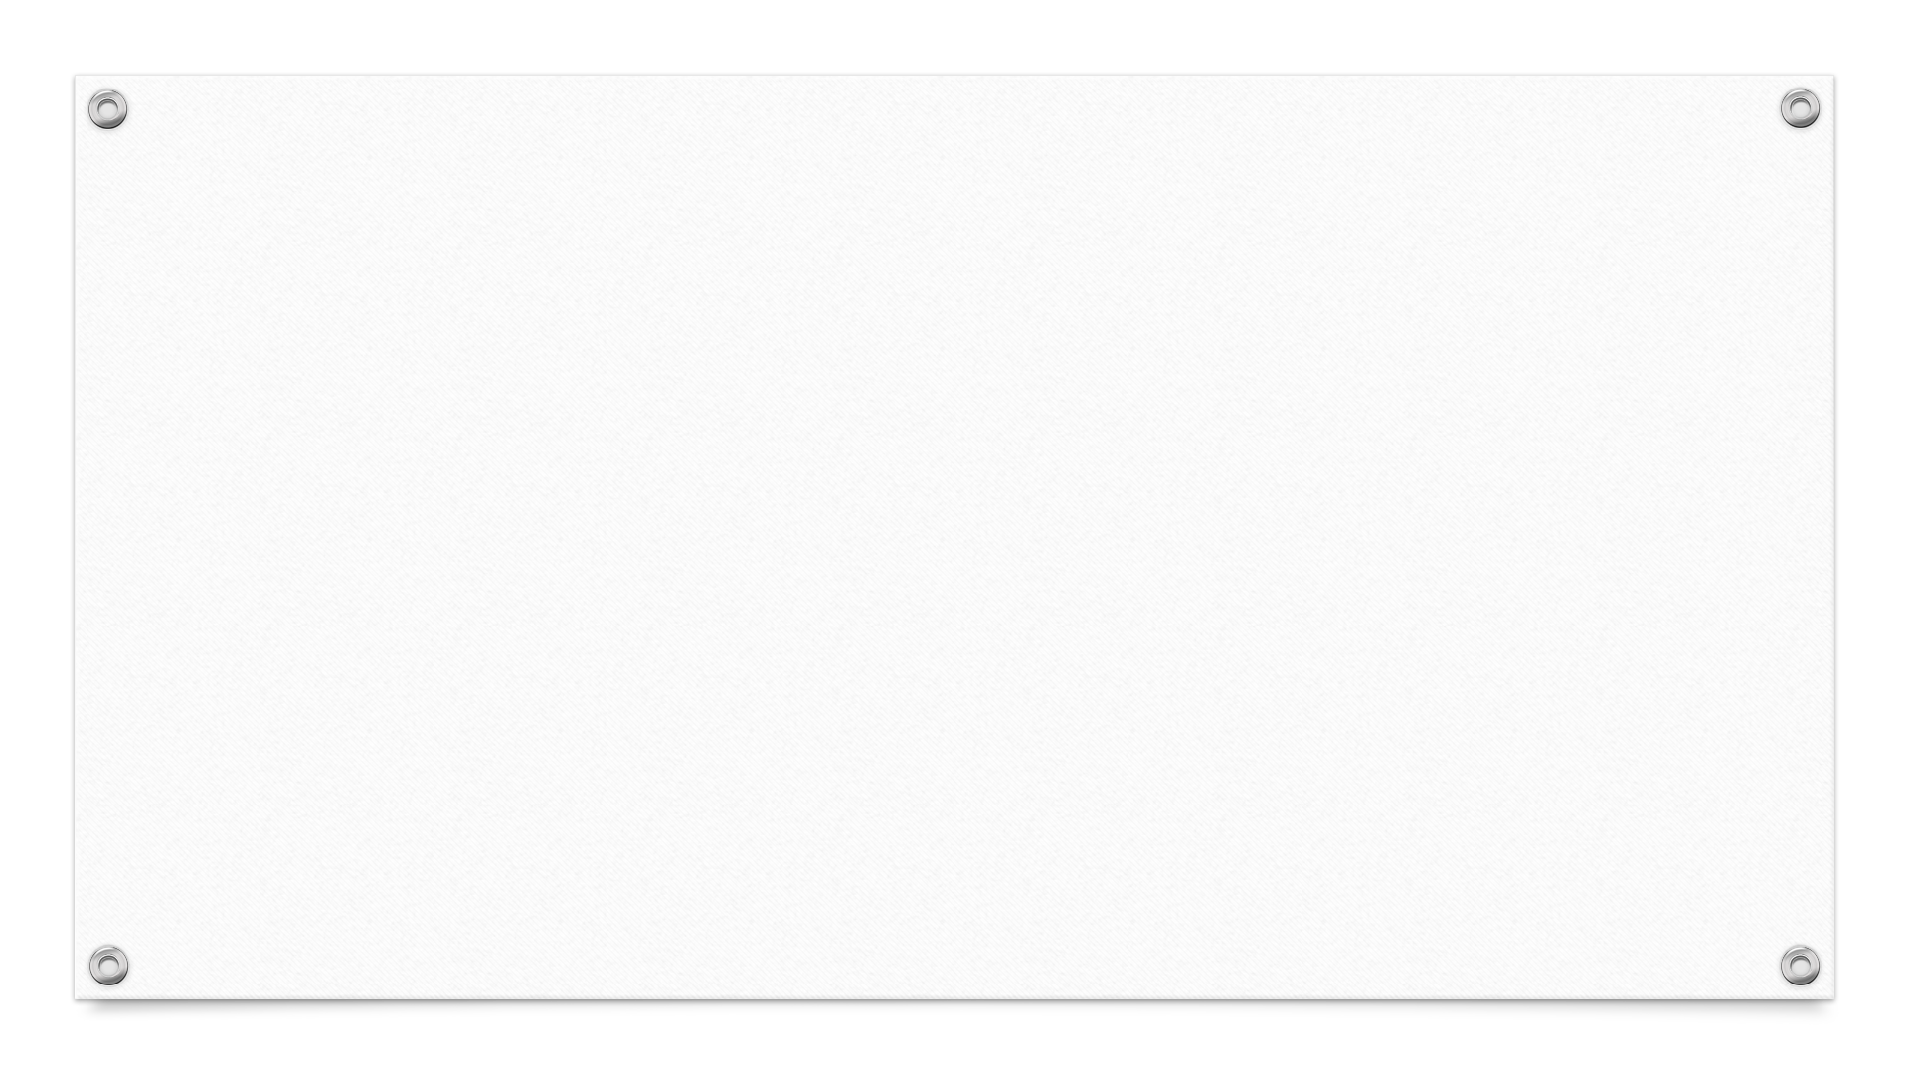

Algorithm
&
Data Structure
TEB1113/TDB1023
LAB SESSION 1
Introduction & OOP

Slide 2
LEARNING OUTCOMES
Students should be able to:
determine input, process, output when solving given computing problem.
design algorithm to depict steps involved in solving given computing problem.
use JCreator to write, compile and run java program.
understand how to use classes.

Slide 3
Algorithm
ALGORITHM:
It is a step-by-step procedure designed to solve a problem.
It has a beginning, end, and a number of steps.
Short algorithms can be combined to perform complex tasks such as writing a computer program.
Pseudocode:
Uses English-like phrases.
A flowchart:
It is a visual or graphical representation of an algorithm.
It consists of special geometric symbols connected by arrows.

Slide 4
Algorithm & Syntax of C++ Program (Cont.)
Start / Stop |  | Rectangle with rounded sides used to indicate either START/ STOP of the program.
Process Indicator |  | Rectangle is used to indicate any set of processing operation such as for storing, arithmetic operations, …etc.
Input / Output Indicators |  | Parallelograms are used to represent input and output operations. Statements like INPUT, READ and PRINT.
Decision Makers / Condition |  | Diamond is used for indicating the step of decision making and is known as decision box. They are used to test the conditions or ask questions and depending upon the answers, the appropriate actions are taken by the computer.

Slide 5
Algorithm & Syntax of C++ Program (Cont.)
On-page Connectors |  | Circles are used to replace long lines on a flowchart page.
Flow Lines |  | This indicates the direction being followed in the flowchart. In a flowchart, every line must have an arrow on it to indicate the direction. The arrows may be in any direction.
Off-page Connectors |  | It is used when the target is on another page.

Slide 6
Activity #1
Problem:
Design a program that read three numbers one by one from a keyboard. Then, the
program will sum up all the numbers and display the sum.
Questions:
State the input(s) needed, and the output(s) expected by the program.
Sketch the algorithm (in pseudocode and flowchart) for solving the problem.

Slide 7
Activity #1 (Cont.)
Question 1:
State the input(s) needed, and the output(s) expected by the program.
Answer:
INPUT are:- num1, num2, num3.
PROCESS are:- summation.
OUTPUT are:- display sum.

Slide 8
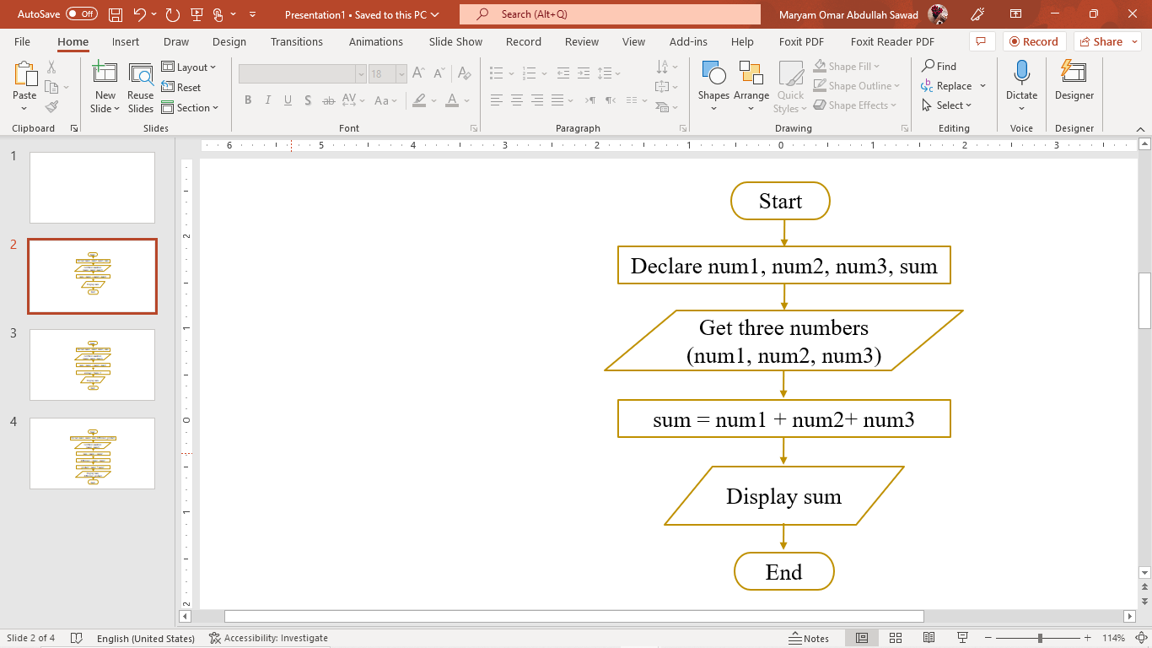
Activity #1 (Cont.)
Question 2:
Sketch the algorithm (either in pseudocode or flowchart)
for solving the problem.
Answer:
Flowchart
Pseudocode
STEP1: Start
STEP2: Declare num1, num2, num3, sum
STEP3: Get three numbers (num1, num2, num3) from keyboard
STEP4: Calculate sum
sum = num1 + num2 + num3
STEP5: Display sum
STEP6: End

Slide 9
Activity #2
Problem:
Design a program that reads 38 students’ scores one by one from a keyboard. Then, the program will determine and display the highest score.
Questions:
State the input(s) needed, and the output(s) expected by the program.
Sketch the algorithm (in pseudocode and flowchart) for solving the problem.

Slide 10
Activity #2 (Cont.)
Questions 1:
State the input(s) needed, and the output(s) expected by the program.
Answer:
INPUT are:- expecting 38 students’ scores
PROCESS are:- to determine the highest score
OUTPUT are:- display highest score

Slide 11
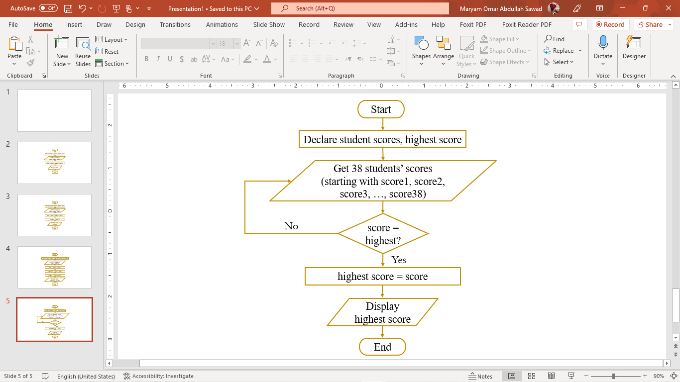
Questions 2: Sketch the algorithm (either in pseudocode or flowchart) for solving the problem.
Activity #2 (Cont.)
STEP1: Start
STEP2: Declare student scores, highest score
STEP3: Get score from keyboard
STEP4: Loop score (38 times) to find the highest
from students’ scores
If score is highest?
then highest = score
Else
get next student score
STEP5: Display highest score
STEP6: End
Pseudocode
Flowchart

Slide 12
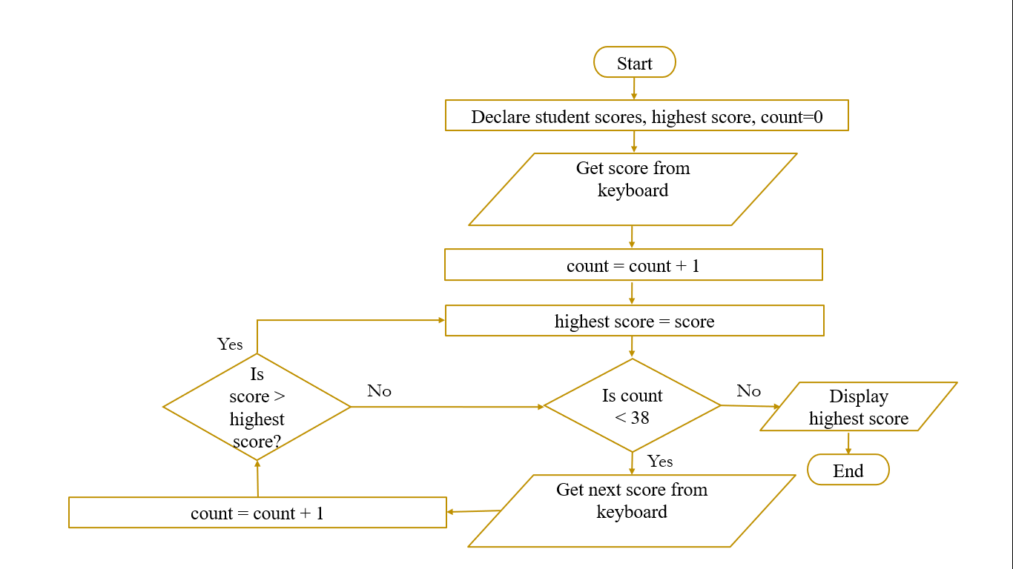
Activity #2 (Cont.)

Slide 13
Activity #3 (Lab Activity)
Problem:
Design a program that reads 38 students’ scores one by one from a keyboard. Then, the program will count and display the number of students who passed the exam. Assume that the passing mark is 40.
Questions:
State the input(s) needed, and the output(s) expected by the program.
Sketch the algorithm (in pseudocode and flowchart) for solving the problem.

Slide 14
Activity #3 (Cont.)
Questions 1:
State the input(s) needed, and the output(s) expected by the program.
Answer:
INPUT are:- expecting 38 students’ scores, count.
PROCESS are:- to determine the number of student who pass the exam.
OUTPUT are:- display number of student pass the exam.

Slide 15
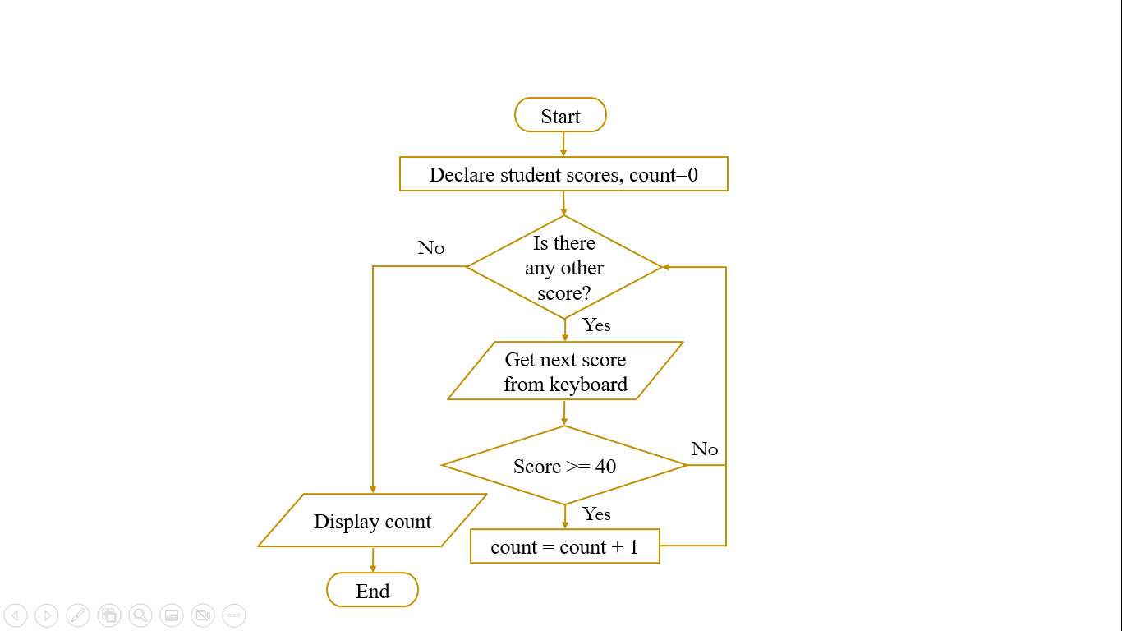
Questions 2: Sketch the algorithm (either in pseudocode or flowchart) for solving the problem.
Activity #3 (Cont.)
Answer:
STEP1: Start
STEP2: Declare student scores, count=0
STEP3: Get 38 students’ scores from keyboard
STEP4: Loop student score and calculate number
of students that pass the exam
If student score >= 40?
count ++ // count = count + 1 // count +=1
STEP5: Display count
STEP6: End
Pseudocode
Flowchart

Slide 16
Activity #4 (Lab Activity)
Problem: Compute Grass Cutting Time
Design an algorithm of a computer program that takes the length and width of a rectangular yard and the length and width of a rectangular house situated in the yard. The program should calculate and display the time required to cut the grass at the rate of two square feet a second.
Question:
Sketch the algorithm (in pseudocode and flowchart) for solving the problem.

Slide 17
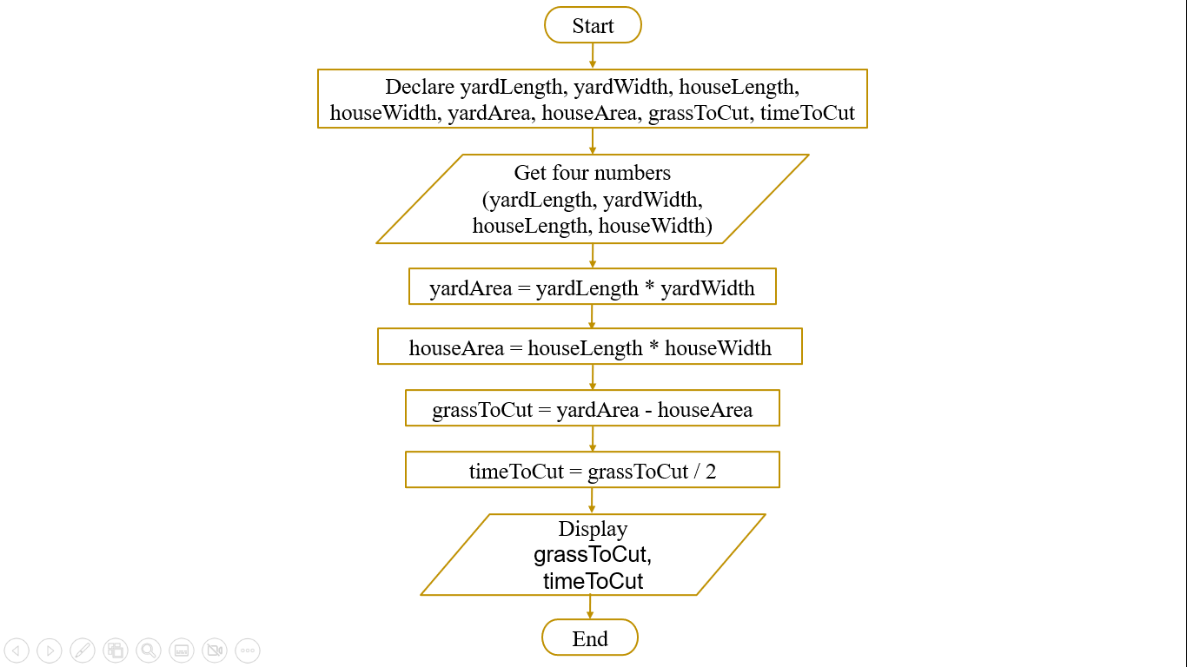
Answer:
Activity #4 (Cont.)
Question:
Sketch the algorithm (either in pseudocode or flowchart) for solving the problem.
Flowchart

Slide 18
Homework
Solve Activity 5 and 6 as homework.
The homework should be submitted on Sunday.
Submit the homework to Ulearn.
One mark will be deducted for each day late submission.
You have to do the homework by yourselves Submission will not be considered in case of copy and paste and you need to do it again.

Slide 19
Activity #5
Problem: Print Examination Scores ##
Design an algorithm of a computer program that receives students’ scores (one by one) for an unknown total number of students (N).
Then, the program will determine
(1) number of students who passed the examination and
(2) number of students who failed the examination.
The passing mark for the examination is 40. Have the program to display the statistic at the end of program run.
Question:
Sketch the algorithm (in pseudocode and flowchart) for solving the problem.

Slide 20
Activity #6
Problem:
Design a program that reads a customer’s name, a purchase amount and a tax code. The tax code has been validated and will be one of the following: 0 – tax exempt (0%) 1 – state sales tax only (3%) 2 – federal and state sales tax (5%) 3 – special sales tax (7%)
The program must then compute the sales tax and the total amount due and print the customer’s name, purchase amount, sales tax and total amount due.
Question:
Sketch the algorithm (in pseudocode and flowchart) for solving the problem.

Slide 21
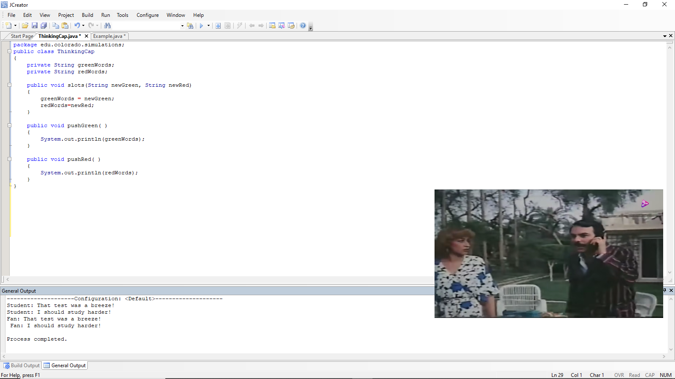
Object oriented programming (oop)

Slide 22
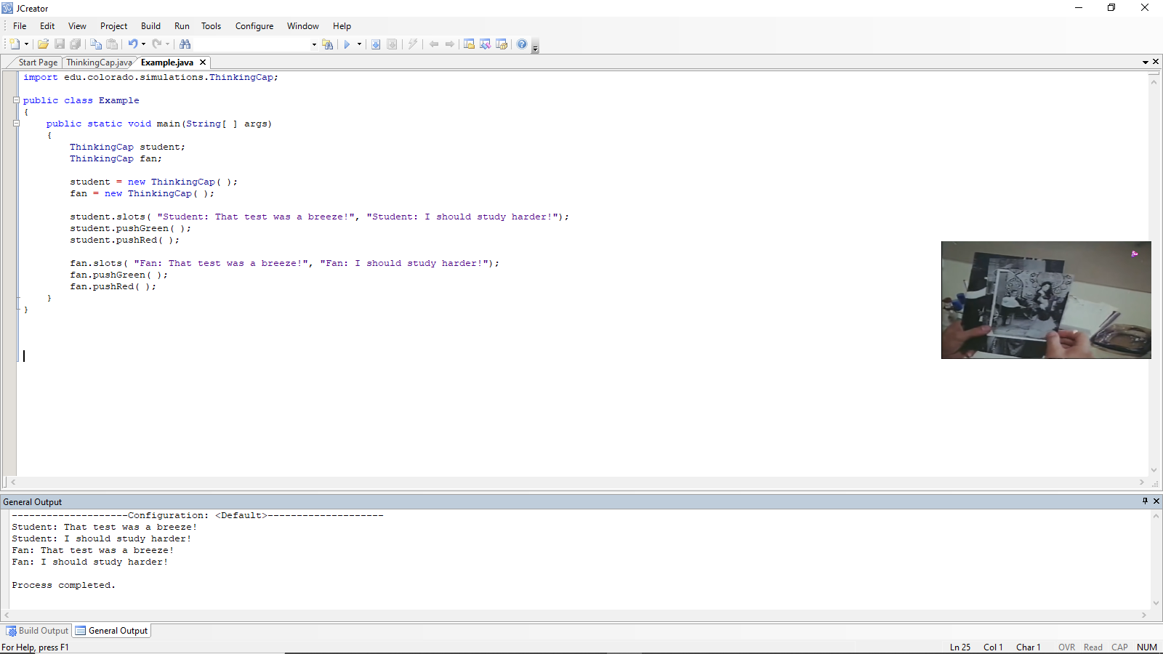
oop (Cont.)

Slide 23
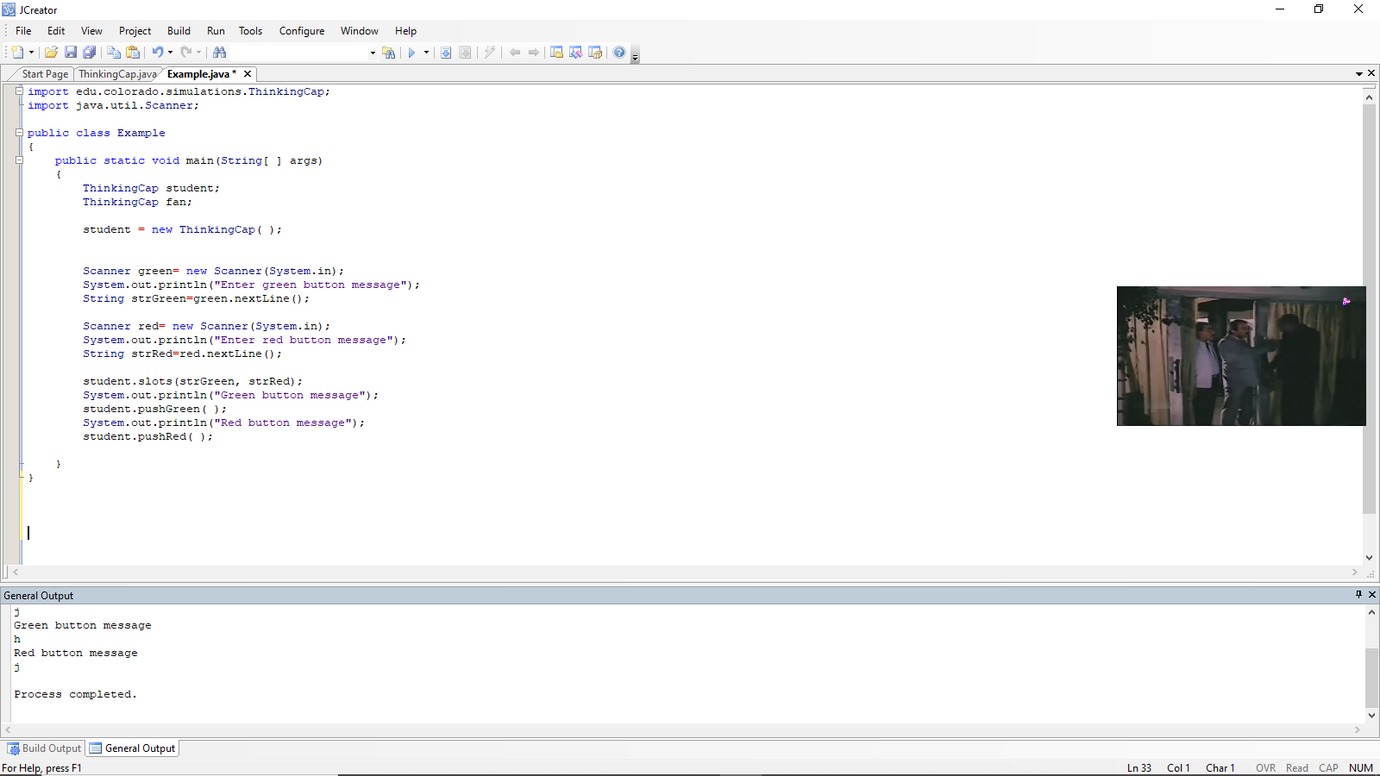
oop (Cont.)

Slide 24
Oop (Lab Activity)
Write program to Add Two Integers.
Write program to Swap Two Numbers.

Slide 25
Homework Rules
for ADS Lab
The homework should be submitted on Saturday of each week. (This rule will be applicable from 2nd homework and above)
Submit the homework to Ulearn.
One mark will be deducted for each day late submission.
You have to do the homework by yourselves. In case of copy and paste the submission will not be considered and you need to do it again (Make mistakes and learn from them but don’t copy and paste).

Slide 26
SEE YOU NEXT WEEK

